Slide 1


Nagarjuna College of Engineering and Technology
(An Autonomous college under VTU,Belagavi)
PROJECT PHASE 1 (18CSP82)
ON
SPEECH EMOTION RECOGNITION USING MLP CLASSIFIER
Submitted by :-
Pallavi S 1NC18CS073
Sushma G S 1NC18CS112
Thrisha B V 1NC18CS116
Yakkali Mani Gopal 1NC18CS121
Under the guidance of
Ms. Swathi S
Senior Asst Professor
Department of Computer Science
And Engineering

Slide 2
CONTENTS
Introduction
Literature Survey on Papers
Existing Method
Proposed Work And Feature Extraction
Hardware/software requirements
Convolution Neural Network
Naive Bayes
K-nearest Neighbour
Block Diagram
Conclusion
Results

Slide 3
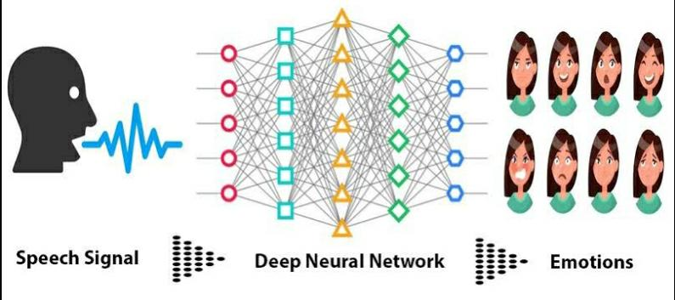
INTRODUCTION
Speech Emotion Recognition(SER) system is generally composed of three parts, the first being speech signal acquisition, then comes the feature extraction followed by emotion recognition.
Artificial Neural Networks are biologically inspired tools for information processing.
Speech recognition modelling by Artificial Neural Networks doesn’t require any prior knowledge of speech process and this technique quickly became an attractive substitute to Hidden Markov Models.
The Conventional Neural Networks of Multi Layer Perceptron type have been increasingly in use for speech recognition and for various other speech processing applications.

Slide 4
LITERATURE SURVEY PAPER -1
Paper: Speech Emotion Recognition with deep learning (2020)
Authors: Hadhami Aouani and Yassine Ben Ayed
Have proposed an approach for automatically detecting emotions in speech that explores some characteristics of how speech signals are detected and meta-information of the signals are calculated for labeling its emotion.
Features like 39 coefficients of Mel Frequency Cepstral Coefficients, Zero Crossing Rate, Harmonic to Noise Rate are used.
In this paper , they have used SVM algorithm for training the machine.

Slide 5
LITERATURE SURVEY PAPER -1
Its accuracy is 73.3%
ADVANTAGES:
It is memory efficient.
It is more effective in high dimensional spaces.
DISADVANTAGES:
It couldnot classify disgust emotion.
Not suitable for large datasets

Slide 6
LITERATURE SURVEY PAPER -2
Paper: Machine Learning Based Speech Emotions Recognition System (2019)
Authors: Yogesh Kumar and Manish Mahajan
Have proposed an approach to automatically detect emotions in speech of a speaker that explores some characteristics of how speech signals are detected and meta-information of the signals.
In this paper , they have used KNN algorithm for detecting emotions in speech signals. Features like MFCC , LPCC are used for data preprocessing and feature extraction.

Slide 7
LITERATURE SURVEY PAPER -2
Its accuracy is 65.7%.
ADVANTAGES:
KNN has less computation time.
KNN is simple to interpret.
DISADVANTAGES:
It has less accuracy.
It’s accuracy depends on data.
KNN require high memory.

Slide 8
EXISITNG SYSTEM
Speech Emotion Recognition is widely used in this modern computer science world. Emotion acts as medium through which a person can express their feelings, with we can determine the person's state of mind.
The Process of detecting emotions is bit tough because each and every single individual will have different tone. To overcome all these difficulties scientists used various deep learning and machine learning techniques.
Speech Emotion Recognition is one of the booming research topics in the computer science world.
DISADVANTAGE
1. It can cause poor accuracy prediction.
2. It took longer to process the dataset during the training phase.
3.This comprises during a excessive error rate.

Slide 9
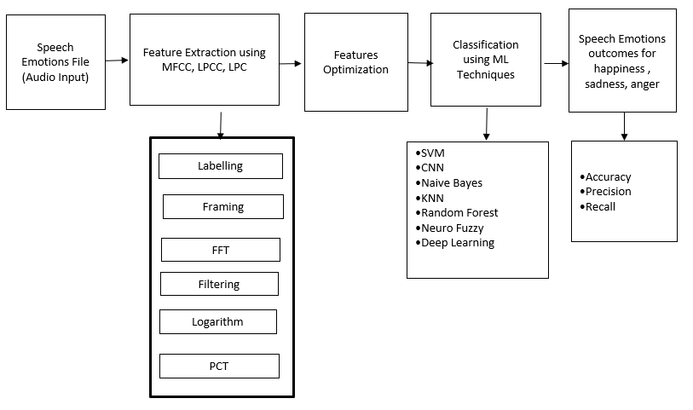

Slide 10

PROPOSED WORK AND FEATURE EXTRACTION
Here we use various functions where we extract mfcc, mel features and others from audio files. It consists of 4 parameters.
chroma consists of 12 pitch classes of Mel. Here the audio files will be read and they will be classified in to arrays Speech.
In this proposed system we will use MLP classifier where the speech signals will undergo feature extraction and model training.
The feature extraction and model training will be done based on pitch of the speech signals.
Framing, hamming and windowing helps in data preprocessing
This process helps in converting an acoustic signal, captured by microphone in to a set of characters

Slide 11
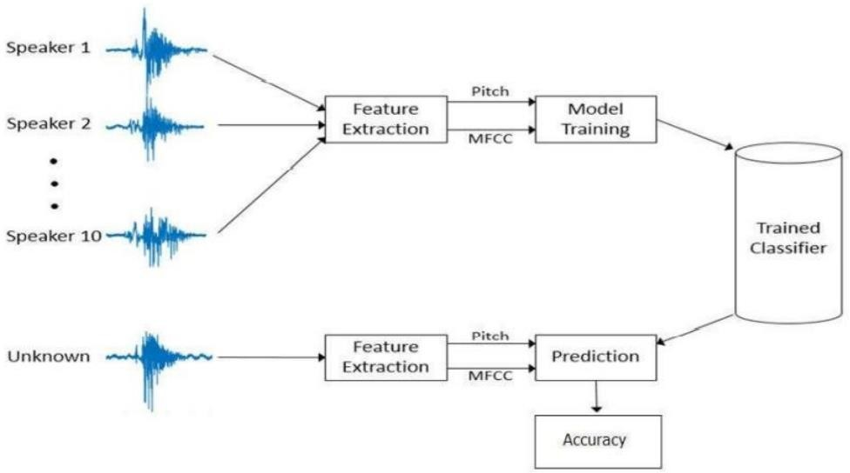
With this human computer interaction be improved by implementing automated SER
Helps to reduce human intervention
Along with DFT we use DCT(Discrete Cosine Transform) with this the short-term energy is displayed on Mel frequency scale.
MFCC helps in identifying the airline reservation and also helps in the process of recognizing the emotions and voices which further increases the security..

Slide 12
HARDWARE/SOFTWARE REQUIREMENTS
HARDWARE/SOFTWARE REQUIREMENTS
ARE/SOFTWARE REQUIREMENTS
Hardware Requirements :
CPU : Intel i5 processor with minimum of 7th generation.
RAM : Minimum of 8GB.
Operating System : Ubuntu or Microsoft Windows 10.
Software Requirements :
Anaconda , Jupyter Notebook or Google Colab.
Kaggle for datasets.

Slide 13
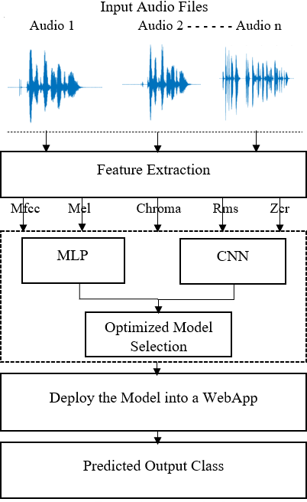
SYSTEM DESIGN
System Architecture

Slide 14
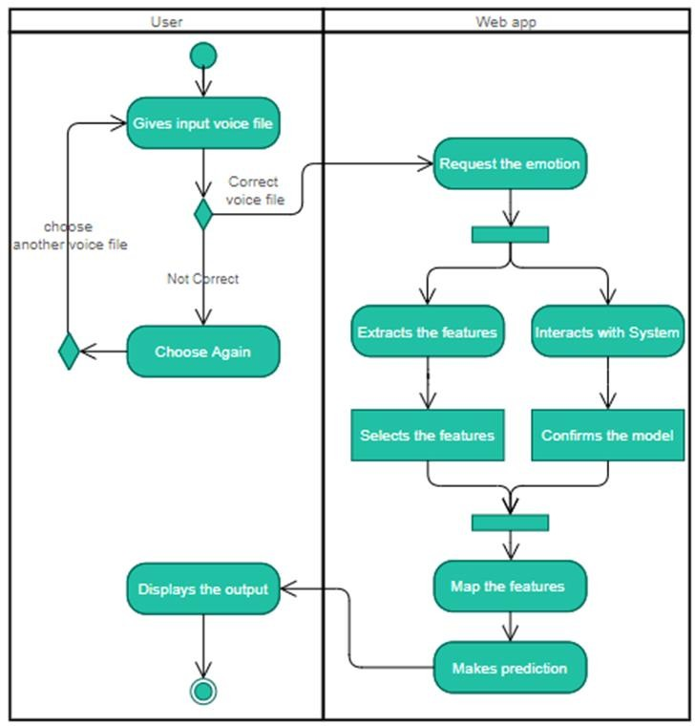
Activity Diagram

Slide 15
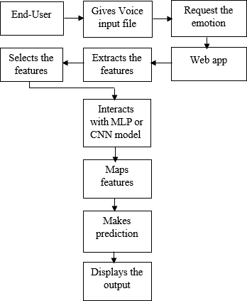
Runtime Pipeline Of System

Slide 16
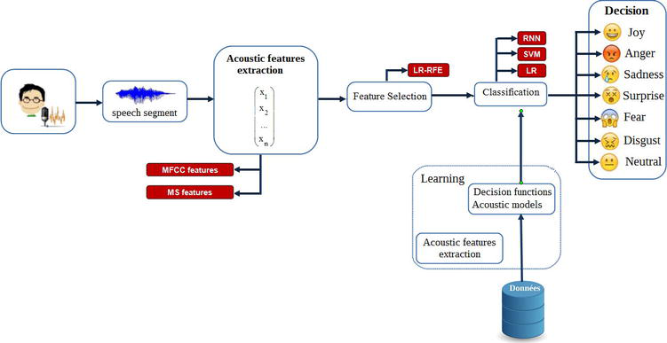
Block Diagram

Slide 17
CONCLUSION
From the above speech emotion recognition technique we can detect the emotions of the people just by listening their voices .
This technique further helps us in implementing the process of detecting speech in various machines such as cars where the car get automatically gets stopped when a person is facing anger issues.
We can attach this technique with various industries such as cyber security, call centers, military security purposes, robotics etc.
With this emotion detection techniques the psychiatric department can grow very vast where the doctors can easily detecting the people's emotions.
Concepts of Machine Learning and Artificial Intelligence plays major roles in this process thus we can say that there is a lot of scope in the development of this kind of techniques.
Here we used some of the libraries called librosa, numpy, pyaudio etc

Slide 18
Thank You☺

